Slide 1
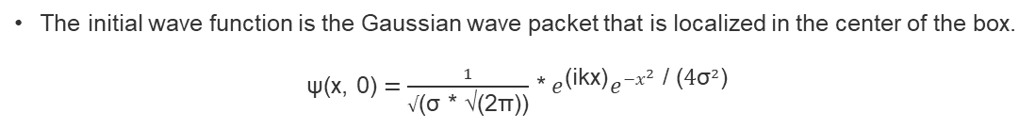
Crank-Nicolson algorithm
- Mitul Akbari Homework Problem set: 3
- Prof. Dr. Daria Gorelova
Solve computationally the 1D time-dependent Schrödinger equation for a particle in an infinite potential well using the Crank-Nicolson algorithm.
The initial wave function is the Gaussian wave packet that is localized in the center of the box.
ψ(x, 0) $=\frac{1}{√\text{(}\text{σ}\text{ ∗ √(2}\text{π}\text{))}}$ * $e^{\text{(}\text{ikx}\text{)}}e^{{−x}^{2} \text{/ (}{\text{4}\text{σ}}^{2}\text{)}}$

Slide 2
Crank-Nicolson algorithm
Here are some of the paraameters used for generating wavefunction propogation animation without step potential. And it behaves as expected.
Parameters | Values
total time period | 30 fs
sigma parameter for gaussian wave function | 10^10
total length of 1D space(x coordinate) | 100 A°
wave vector for the wavefunction | 1 rad/A°
mass of particle | 9.1e-19 kg
coordinate_of_potential | 150 A°

Slide 3
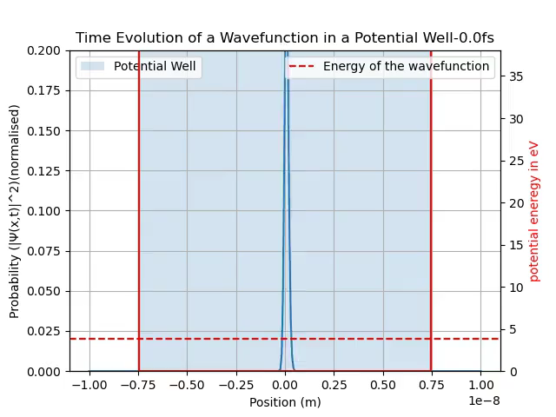
Crank-Nicolson algorithm

Slide 4
Crank-Nicolson algorithm
Here are some of the parameters used for generating animation with step potential.
Parameters | Values
total time period (fs) | 30
sigma parameter for gaussian wave function | 10^10
total length of 1D space(x coordinate) | 100 A°
wave vector for the wavefunction (rad/A°) | 1
mass of particle | 9.1e-19
position of the step potential | 50
coordinate_of_potential | 150
height_of_step_potential(in eV) | 10
width of step potential in A° | 2

Slide 5
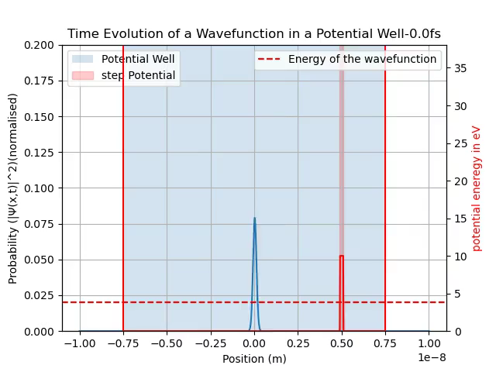
Crank-Nicolson algorithm

